Slide 1
WEB – Technologies - 2 UE16CS403
“EDU-TECH - portal for learning”
Abhishek Narayanan (01FB16ECSO16)
Abhishek Prasad (01FB16ECS017)
Abijna Rao (01FB16ECS019)

Slide 2

INTRODUCTION : -
EDU- NET is an E-Learning platform where instructors and student come together.
The instructors can upload course videos and can put them under various categories.
The students can view the uploaded videos and can also give their valuable feedback.
Both the instructor and the students have their different dashboard to configure their profiles.
Videos uploaded by the instructor are rated between 1-5 on the basis of the comments given by the students.
A machine learning algorithm is used to assign the sentiment value to the comments.

Slide 3
FEATURES : -
REGISTER AS INSTRUCTOR OR STUDENT
BROWSE VIDEOS
UPLOAD VIDEOS
UPLOAD SUBTITLE FILE
CHANGE PROFILE INFORMATION
PLAY , PAUSE VIDEOS IN DIFFERENT QUALITIES ALONG WITH SUBTITLES
RATING VIDEOS ACCORDING TO THE SENTIMENT ANALYSIS OF COMMENTS
RECORD NUMBER OF VIEWS ON A VIDEO

Slide 4
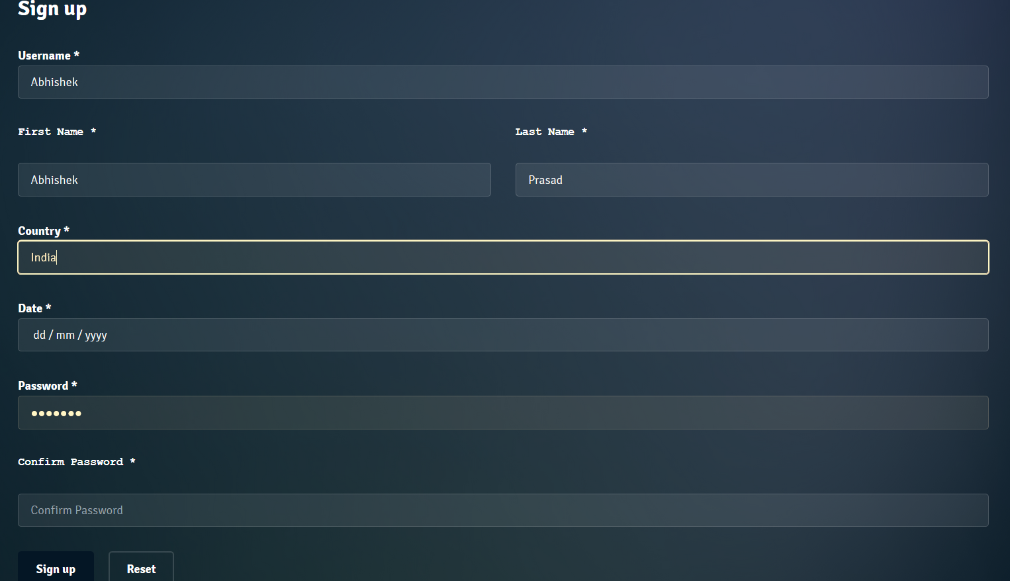
SIGNUP : -
A user can signup as a Instructor or a Student.

Slide 5
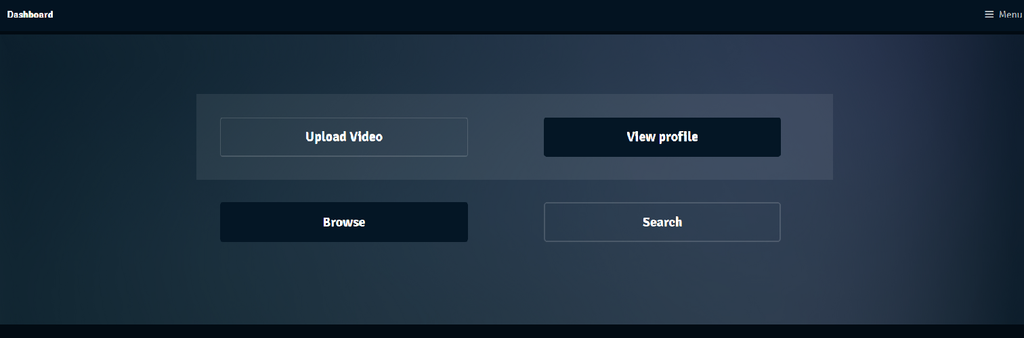
DASHBOARD : -
Dashboard provides the user various functionalities.
It helps him to UPLOAD the video , VIEW PROFILE , BROWSE and SEARCH.

Slide 6
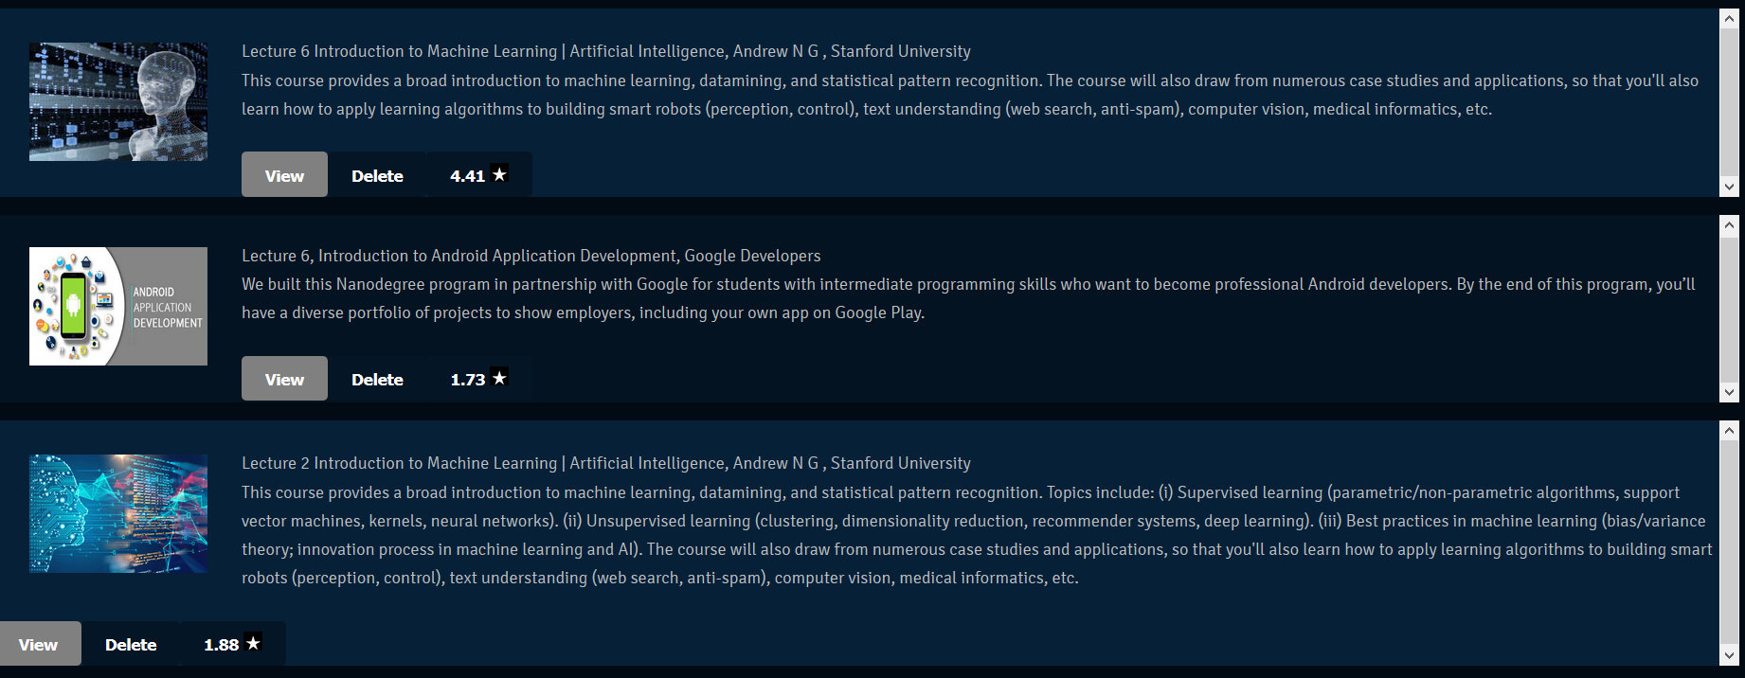
VIEW COURSES : -

Slide 7
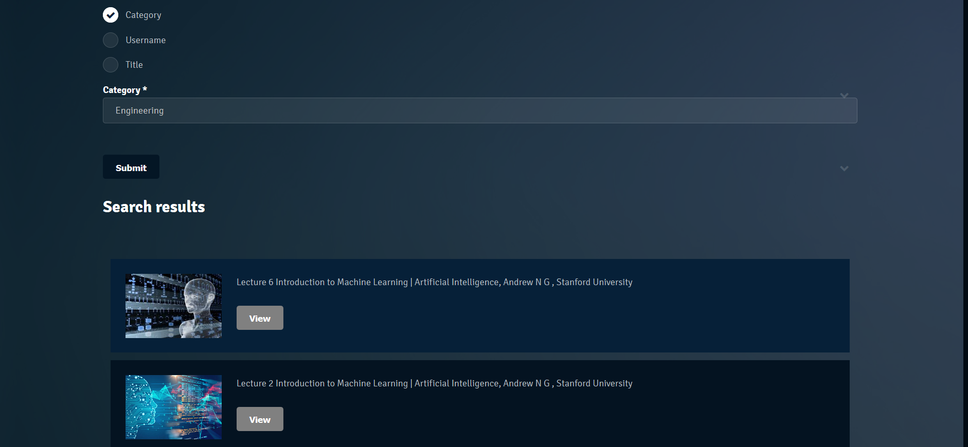
SEARCH : -
The user can search courses/videos via CATEGORY , USERNAME and TITLE.

Slide 8
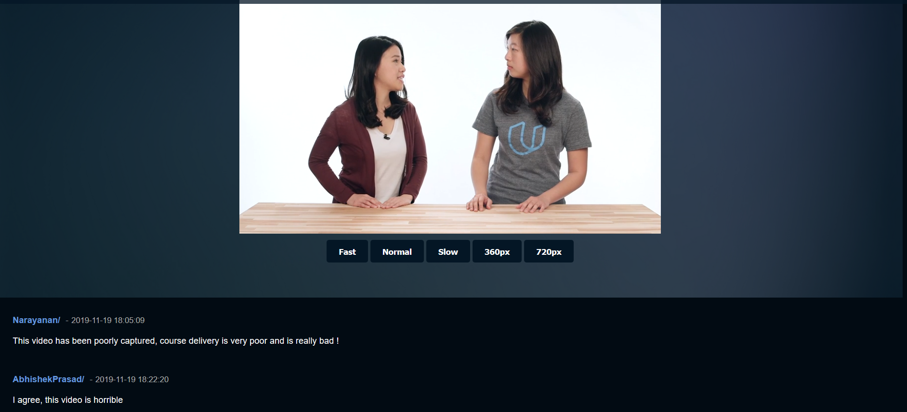
VIDEO STREAMING : -
There are various options in streaming the video.
The user can increase/decrease speed as well as the quality of the video.
There also an option for the user to comment.

Slide 9
TECHNOLOGIES USED : -
HTML
CSS
JAVA SCRIPT ( AJAX )
MySQL
NODEJS
PHP
JQUERY

Slide 10
OTHER TECHNOLOGIES : -
AJAX and REVERSE AJAX PATTERNS : -
PREDICTIVE FETCH
STREAMING
WEB SERVICES
RESTFUL API’S for BACKEND
INTELLIGENT COMPONENT – AUTOMATIC RATING OF VIDEOS USING SENTIMENT ANALYSIS OF THE USER COMMENTS.

Slide 11
THANK YOU

